Slide 1
Spring ApplicationContext

Slide 2

Learning Outcome
After completing this video, you will learn:
ApplicationContext interface
BeanFactory or ApplicationContext?
Types of ApplicationContext
Event handling in ApplicationContext
Built-in events

Slide 3
ApplicationContext
The Interface

Slide 4
The ApplicationContext
What is the ApplicationContext Interface?
In the Spring framework, the interface ApplicationContext represents the IoC container.
The context package adds the ApplicationContext interface.
It enhances BeanFactory functionality in a more framework-oriented style.
The context package also provides the following functionality:
MessageSource
Access to resources
Event. Propagation
Loading of multiple (hierarchical) contexts
Notes:
In the Spring framework, the interface ApplicationContext represents the IoC container. The Spring container is responsible for instantiating, configuring and assembling objects known as beans, as well as managing their life cycles.
The basis for the context package is the ApplicationContext interface, located in the org.springframework.context package.
To allow working in a more framework-oriented fashion, using layering and hierarchical contexts, , the context package also provides the following functionality:
MessageSource, providing access to messages in i18n-style.
Access to resources, such as URLs and files.
Event propagation to beans implementing the ApplicationListener interface.
Loading of multiple (hierarchical) contexts, allowing each to be focused on one particular layer, for example the web layer of an application.

Slide 5
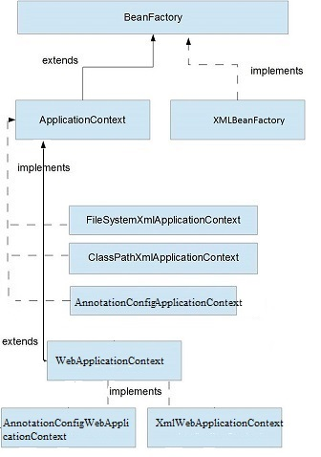
The Context Package
ApplicationContext Hierarchy
In the Spring framework, the interface ApplicationContext represents the IoC container.
Notes:
Deriving from the BeanFactory interface, the ApplicationContext interface provides all the functionality of BeanFactory.

Slide 6
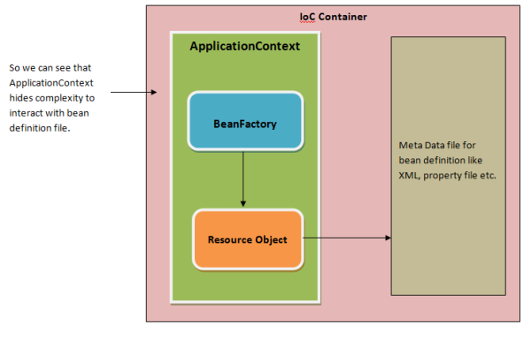
The ApplicationContext
ApplicationContext Interface
Notes:
While the beans package provides basic functionality for managing and manipulating beans, including in a programmatic way, the context package adds the ApplicationContext interface, which enhances BeanFactory functionality in a more framework-oriented style.

Slide 7
The ApplicationContext
BeanFactory or ApplicationContext?
Use an ApplicationContext unless you have a really good reason for not doing so.
Feature matrix that lists what features are provided by the BeanFactory and ApplicationContext interfaces:
Feature | BeanFactory | ApplicationContext
Bean instantiation/wiring | Yes | Yes
Automatic BeanPostProcessor registration | No | Yes
Automatic BeanFactoryPostProcessor registration | No | Yes
Convenient MessageSource access (for i18n) | No | Yes
ApplicationEvent publication | No | Yes
Notes:
As the ApplicationContext includes all functionality of the BeanFactory, it is generally recommended that it be used in preference to the BeanFactory, except for a few limited situations such as in an Applet, where memory consumption might be critical and a few extra kilobytes might make a difference.
However, for most 'typical' enterprise applications and systems, the ApplicationContext is what you will want to use.

Slide 8
Types of ApplicationContext
Implementations of ApplicationContext

Slide 9
Types of ApplicationContext
Overview
Some of the common types of ApplicationContext are:
AnnotationConfigApplicationContext
AnnotationConfigWebApplicationContext
XmlWebApplicationContext
FileSystemXMLApplicationContext
ClassPathXmlApplicationContext
Notes:
Spring provides different types of ApplicationContext containers suitable for different requirements. These are implementations of the ApplicationContext interface. So let's take a look at some of the common types of ApplicationContext.

Slide 10
Types of ApplicationContext
Overview
Some of the common types of ApplicationContext are:
AnnotationConfigApplicationContext
AnnotationConfigWebApplicationContext
XmlWebApplicationContext
FileSystemXMLApplicationContext
ClassPathXmlApplicationContext
Notes:
Spring provides different types of ApplicationContext containers suitable for different requirements. These are implementations of the ApplicationContext interface. So let's take a look at some of the common types of ApplicationContext.

Slide 11
AnnotationConfigApplicationContext
Overview
Introduced in Spring 3.0.
Can take classes annotated with @Configuration and @Component.
Can also take JSR-330 metadata as input.
ApplicationContext context = new AnnotationConfigApplicationContext(AccountConfig.class); AccountService accountService = context.getBean(AccountService.class);
Notes:
First, let's see the AnnotationConfigApplicationContext class, which was introduced in Spring 3.0.
It can take classes annotated with @Configuration, @Component, and JSR-330 metadata as input.
So, let's see a simple example of using the AnnotationConfigApplicationContext container with our Java-based configuration:

Slide 12
AnnotationConfigWebApplicationContext
Overview
Introduced in Spring 3.0.
Web-based variant of AnnotationConfigApplicationContext.
This class can be used to configure Spring's ContextLoaderListener servlet listener.
Can also be used to configure a Spring MVC DispatcherServlet in a web.xml file.
We can also configure this application context container programmatically.
Notes:
Moreover, from Spring 3.0 onward, we can also configure this application context container programmatically. All we need to do is implement the WebApplicationInitializer interface:

Slide 13
AnnotationConfigWebApplicationContext
Example
public class MyWebApplicationInitializer implements WebApplicationInitializer {
public void onStartup(ServletContext container) throws ServletException {
AnnotationConfigWebApplicationContext context = new AnnotationConfigWebApplicationContext(); context.register(AccountConfig.class); context.setServletContext(container); // servlet configuration
}
}
Notes:
Moreover, from Spring 3.0 onward, we can also configure this application context container programmatically. All we need to do is implement the WebApplicationInitializer interface:

Slide 14
XmlWebApplicationContext
Overview
Used for the XML based configuration in a web application.
We can configure it in web.xml or implement the WebApplicationInitializer interface.
public class MyXmlWebApplicationInitializer implements WebApplicationInitializer {
public void onStartup(ServletContext container) throws ServletException {
XmlWebApplicationContext context = new XmlWebApplicationContext();
context.setConfigLocation("/WEB-INF/spring/applicationContext.xml"); context.setServletContext(container); // Servlet configuration
}
}
Notes:
If we use the XML based configuration in a web application, we can use the XmlWebApplicationContext class.
As a matter of fact, configuring this container is like the AnnotationConfigWebApplicationContext class only, which means we can configure it in web.xml, or implement the WebApplicationInitializer interface:

Slide 15
FileSystemXMLApplicationContext
Overview
Loads an XML-based Spring configuration file from the file system or from URLs.
Useful for test harnesses, as well as standalone applications.
An example of using this class:
String path = "C:/myProject/src/main/resources/applicationcontext/account-bean-config.xml";
ApplicationContext context = new FileSystemXmlApplicationContext(path);
AccountService accountService = context.getBean("accountService", AccountService.class);
Notes:
We use the FileSystemXMLApplicationContext class to load an XML-based Spring configuration file from the file system or from URLs.
This class is useful when we need to load the ApplicationContext programmatically.
For example, let's see how we can create this Spring container and load the beans for our XML-based configuration:

Slide 16
ClassPathXmlApplicationContext
Overview
Loads an XML configuration file from the classpath.
Useful for test harnesses, as well as application contexts embedded within JARs.
An example of using this class:
ApplicationContext context
= new ClassPathXmlApplicationContext("applicationcontext/account-bean-config.xml"); AccountService accountService = context.getBean("accountService", AccountService.class);
Notes:
In case we want to load an XML configuration file from the classpath, we can use the ClassPathXmlApplicationContext class.
Similar to FileSystemXMLApplicationContext, it's useful for test harnesses, as well as application contexts embedded within JARs.
So let's see an example of using this class:

Slide 17
Events
Event handling in ApplicationContxext

Slide 18
Event Handling in ApplicationContext
Overview
Event handling in the ApplicationContext is provided through the ApplicationEvent class and ApplicationListener interface.
Every time an ApplicationEvent gets published to the ApplicationContext, the implementing bean will be notified
Notes:
ApplicationContext supports event handling with the help of the ApplicationEvent class and the ApplicationListener interface.
If a bean which implements the ApplicationListener interface is deployed into the context, every time an ApplicationEvent gets published to the ApplicationContext, that bean will be notified.
Essentially, this is the standard Observer design pattern.

Slide 19
Event Handling in ApplicationContext
Built-in Events
Event | Explanation
ContextRefreshedEvent | Published when the ApplicationContext is initialized or refreshed
ContextStartedEvent | Published when the ApplicationContext is started, using the start() method on the ConfigurableApplicationContext interface.
ContextStoppedEvent | Published when the ApplicationContext is stopped, using the stop() method on the ConfigurableApplicationContext interface.
ContextClosedEvent | Published when the ApplicationContext is closed, using the close() method on the ConfigurableApplicationContext interface
RequestHandledEvent | A web-specific event telling all beans that an HTTP request has been serviced (this will be published after the request has been finished).
Notes:
It supports built-in events like ContextStartedEvent, ContextStoppedEvent, ContextClosedEvent, and RequestHandledEvent. Moreover, it also supports custom events for business use cases.
Implementing custom events can be done easily. Simply call the publishEvent() method on the ApplicationContext, specifying a parameter which is an instance of your custom event class implementing ApplicationEvent. Event listeners receive events synchronously. This means the publishEvent() method blocks until all listeners have finished processing the event (it is possible to supply an alternate event publishing strategy via a ApplicationEventMulticaster implementation). Furthermore, when a listener receives an event it operates inside the transaction context of the publisher, if a transaction context is available.

Slide 20

Quick Question
Which of the following statements is true?
​
A. ApplicationContext implements the BeanFactory
B. ApplicationContext inherits from BeanFactory
C. BeanFactory inherits from ApplicationContext
D. BeanFactory implements ApplicationContext

Slide 21
Quick Question
Which of the following statements is true?
​
A. ApplicationContext implements the BeanFactory
B. ApplicationContext inherits from BeanFactory √
C. BeanFactory inherits from ApplicationContext
D. BeanFactory implements ApplicationContext

Slide 22

Summary
This video gave a brief description of:
ApplicationContext interface
BeanFactory or ApplicationContext?
Types of ApplicationContext
Event handling in ApplicationContext
Built-in events

Slide 23

Thank You!

